Slide 1


New York City Airbnb Listings
Predicting the Price
Notes:
For this capstone I decided to look at Airbnb listings in New York City and tried to predict their prices.

Slide 2

Airbnb in NYC
NYC nation’s largest short-term rental market
NYC largest domestic market for Airbnb
More than 50,000 apartment rental listings
One listing per address
Notes:
To start off New York City is the nation’s largest short-term rental market and it is the largest domestic market for Airbnb with over 50,000 apartment rental listings. However, Airbnb does not permit hosts to have more than one listing at any single address in New York City so each listing pertains to one unique address.

Slide 3
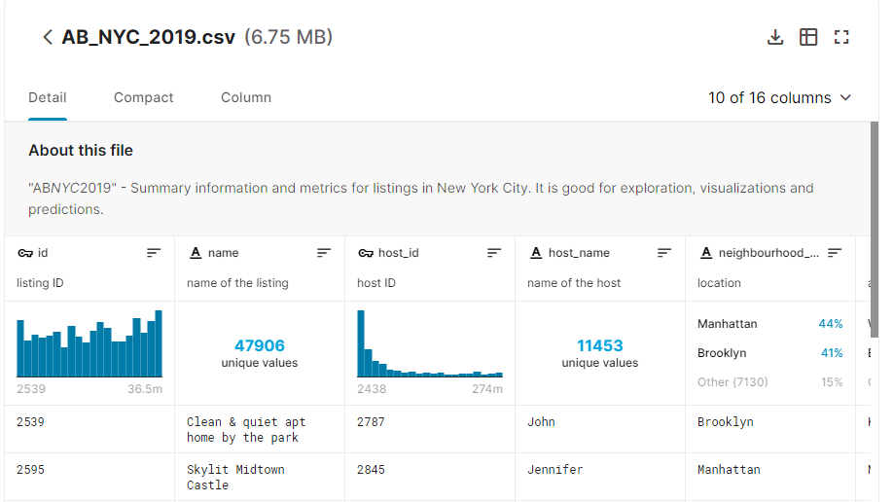
Data Source
Kaggle database
Describes listing activity and metrics for NYC in 2019
48,000 entries
Notes:
I found the data I used on Kaggle, it describes about ten different listing activities and metrics for New York City in 2019 and it has almost 50,000 listings to look at.

Slide 4

Data Preparation
Fairly easy to clean up
Fill NaNs in reviews/month with 0
Fill NaNs in name columns with ‘Unknown’
Notes:
As a pleasant surprise, the dataset came mostly clean with only a few columns having NaNs and they were very easy to fill according to their values.

Slide 5
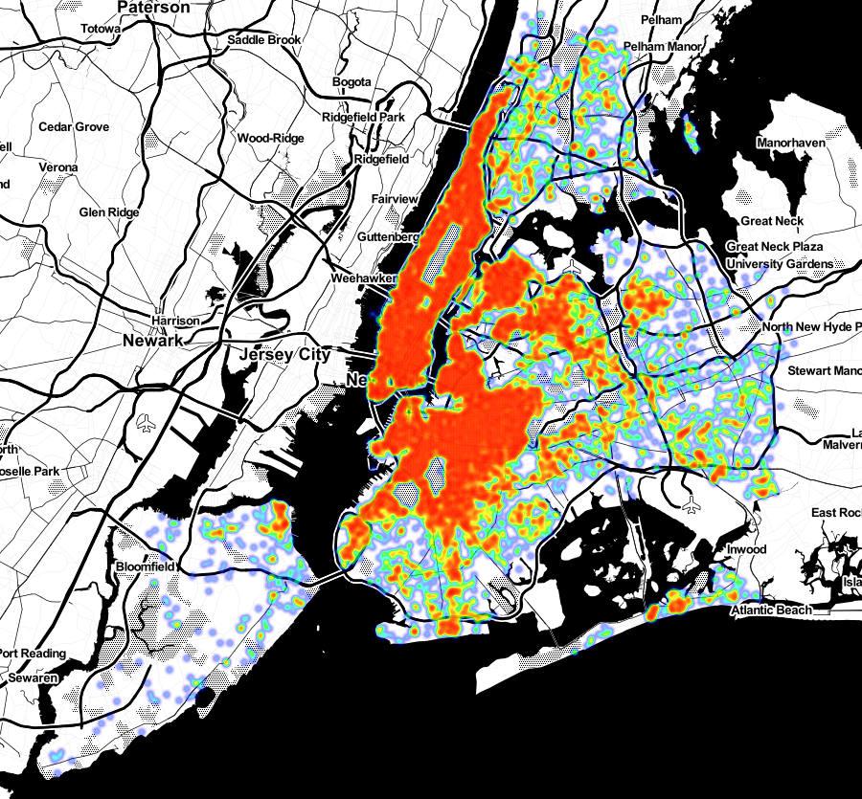
Initial Lookthrough
Listings mostly in Manhattan and Brooklyn
Some in Queens
Very few in Staten Island and Bronx
Notes:
The first thing I wanted to do was to take a look at how these listings were distributed across the city. I found that most of these were in the Manhattan and Brooklyn area and a small number of them in Bronx and Staten Island.

Slide 6

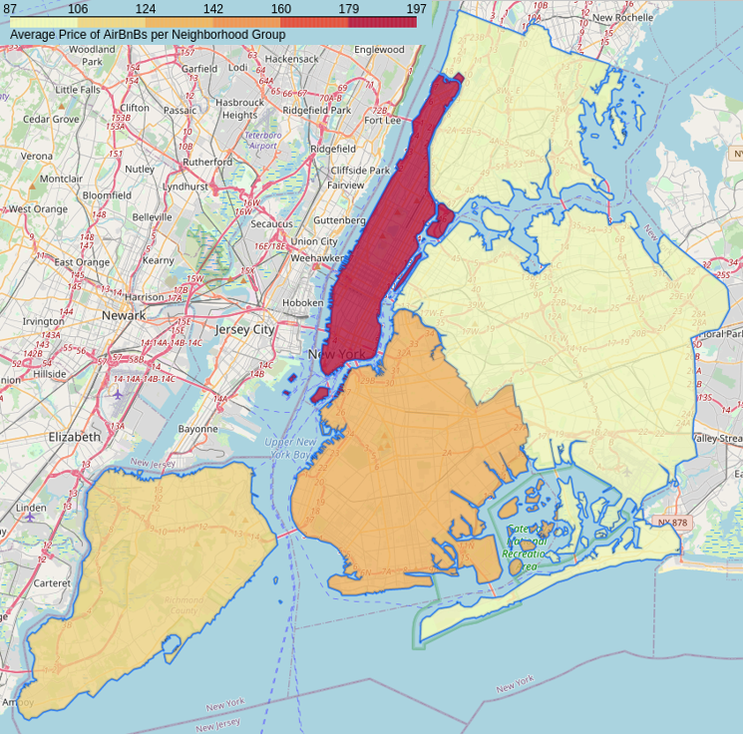
Price Distribution
Higher clustered areas more expensive on average
Staten Island a bit pricier despite density
Notes:
I grouped each borough on average price and was not surprised to find that the more dense boroughs had a higher average price per listing.

Slide 7
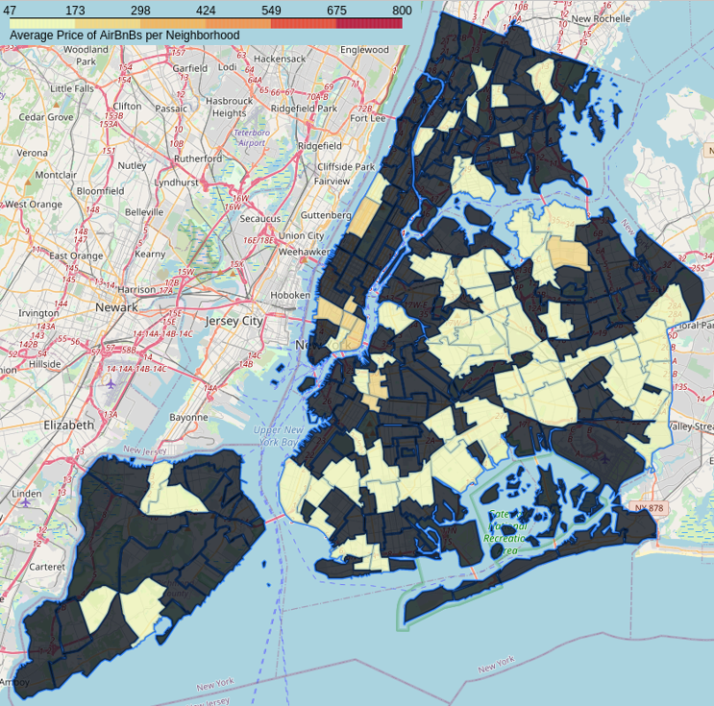
Price Distribution
Key on neighborhood
Data neighborhood listed by host
Does not match formal name of neighborhood
Notes:
Similarly, I wanted to look at the average price per neighborhood, but because each host entered their neighborhood, the official names of the neighborhoods weren’t always used and therefore I could not connect my geojson file to the neighborhood column.

Slide 8

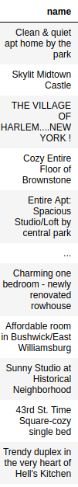
Model Data
A lot of information in listing name
Vectorize for total of ~8000 features
NMF 100 components
Each new feature based on probabilities
Notes:
When looking at the data, I found there was a lot of information contained in the listing name column but since all the entries were strings I had to transform them into numbers in such a way where it would reflect the information each string contained. To do this I vectorized the name column for a total of about 8000 features, and then used non-negative matrix factorization to find 100 latent topics. I then created 100 new columns, and each column was filled with the probability that the original listing name belonged to that latent topic. So for each listing, the sum of those 100 columns added up to 1.

Slide 9
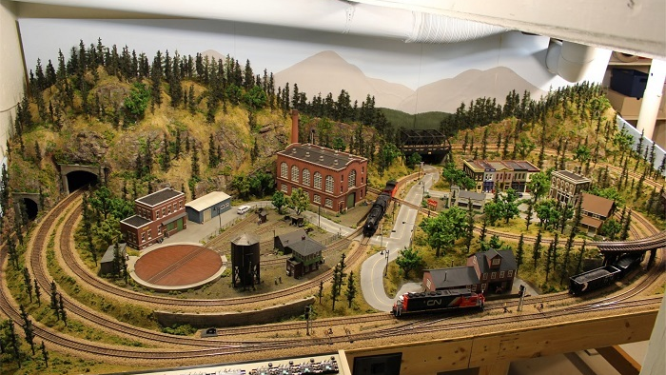
Ready for model to train!
X: Location, y: Price Minimum nights, Number of reviews, Reviews per month, Host listings count, Days available in year, Room type, and the 100 NMF labels.
Notes:
Having done all that, I was ready to start training some models. My X matrix contained things like location, review information, and the 100 columns that reflected the name column. And my target, of course, was my price column.

Slide 10
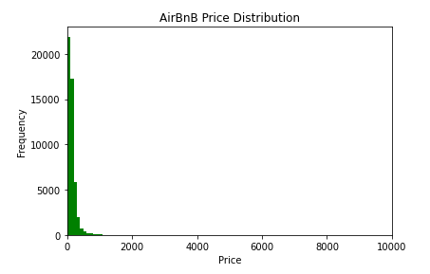
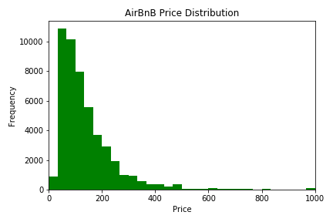
Price Distribution
Notes:
Now the big mistake I made, was looking at this top chart, and thinking to zoom in on the x-axis. I thought okay a few above 500 but it looks fine.

Slide 11

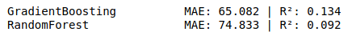
Initial Models
Model with binary columns
Model with probabilities
Notes:
I trained my first couple of models and my R squared scores were horrible. I saw some improvement with the probability columns rather than just binary columns but it was still nothing to reliably predict on. This is where I started to panic a little bit thinking I wouldn’t be able to predict price from the information I had alone.

Slide 12
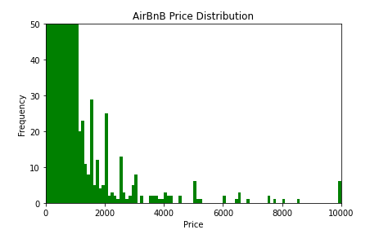
Price Distribution
Quite a few number of listings above $1,000
Some as high as $10,000
Notes:
So I went back and if you zoom on the y-axis, you can see there’s actually a lot more higher priced listings than what I originally saw. Some even as high as $10,000.

Slide 13
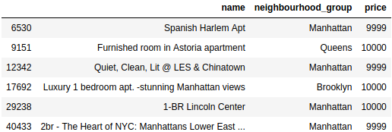
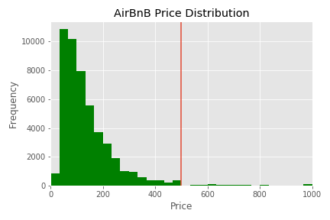
Price Cutoff
Not much information in listing name
Dummy price to negotiate later
Train on data with prices lower than $500
Retained 94% of entries
Notes:
I looked at these listings with crazy high prices and saw that the names were not very descriptive. Something like 1 bedroom Lincoln Center costing $10,000 was a hard correlation to make. I did a little digging and found that in some cases, hosts will set a very high price on the listing just to stand out, but will then negotiate that price down once contacted. These listings would be very hard to predict on and would damage my model’s overall ability to predict prices, so I decided to only look at the data that had prices lower than $500. I would get rid of any anomalies and still retain 94% of my data.

Slide 14

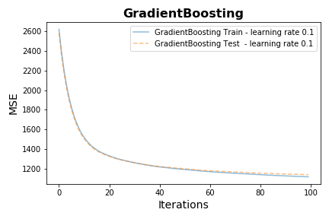
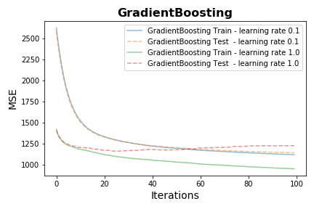
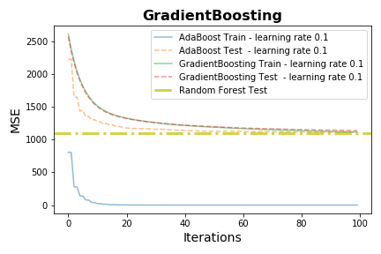
Adjusted Models
Staged predictions MSE with Train and Test
Different learning rates
Different regressors
Notes:
With the adjusted price, the new models were looking much better. I looked at some simple things at first like learning rate, and tried out different regressors to see how they performed on the train and test sets.

Slide 15
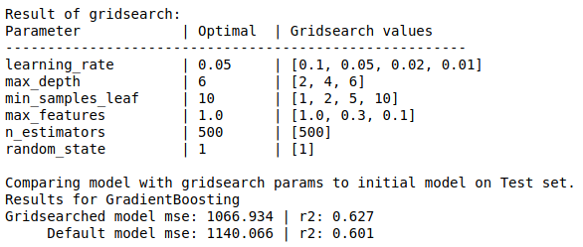
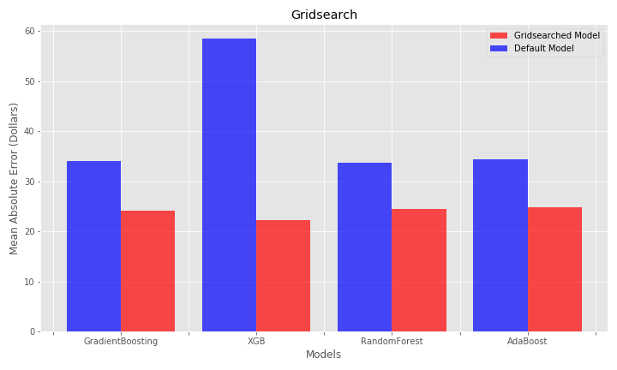
Grid Searching
Time limited
Many total fits
XGB outperforming with optimal parameters
Notes:
To fully optimize my models, I wanted to use grid search and find the hyperparameter combination that would give me the lowest error and highest R squared value. I want to mention that this part took the majority of my time (my computer has not been shut down this entire week), but after numerous hours of watching models train, I got my best scores with the XGBoost Regressor. It needed more hyperparameter tuning than the other models but it seemed to be worth it.

Slide 16
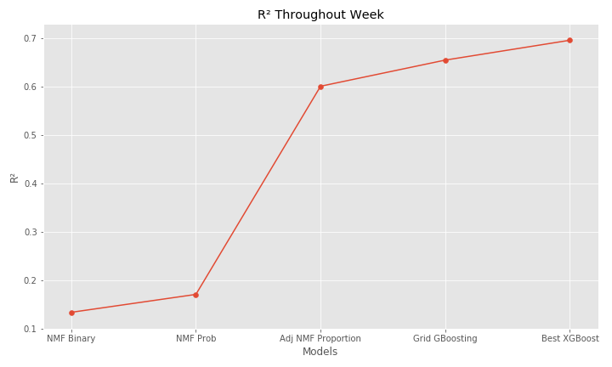
Weeklong Progress
Big jump when adjusting prices looked at
Gradual increase as optimal parameters were implemented
Notes:
And just to kind of look at my progress throughout the week, all in all my R squared made the biggest jump once I took the outlying prices into account and adjusted accordingly, but I did then get a gradual increase as I tuned around for the best hyperparameter combinations.

Slide 17
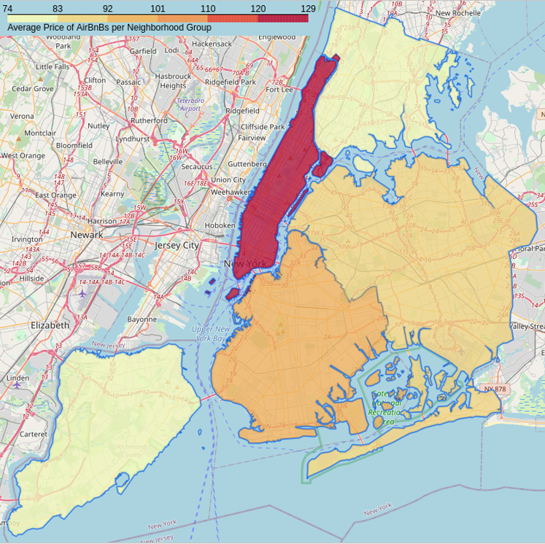
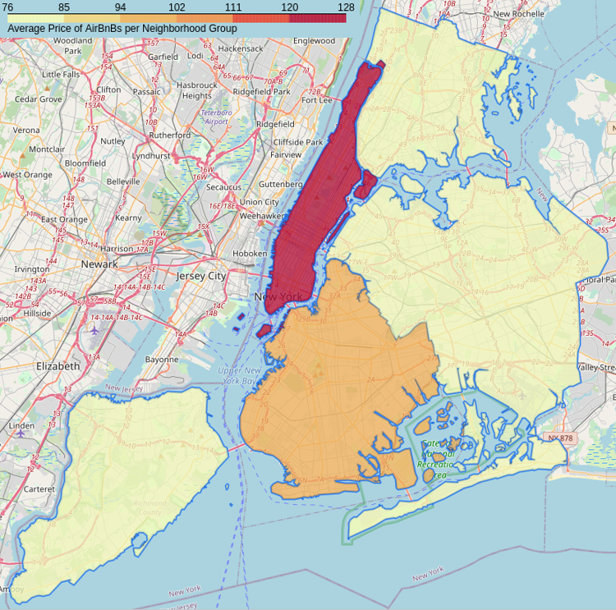
Results
Actual
Predicted
Notes:
Looking at the results from the best model, you can see that the scale remained basically the same and most of the boroughs stayed in the same average price range, but the model does predict the average price in Queens to be lower than the actual average price there so it’s not a perfect model.

Slide 18

Future steps
Find way to determine if price on listing is dummy price
Train on larger scale
Notes:
Some future steps to take would be to develop a way of determining if the price listed is a dummy price, and then removing it from the data in order to avoid removing any really high prices that were legitimate. And also training on a larger scale since this data set only included listings in New York City, so perhaps looking at something like countrywide data.

